Slide 1
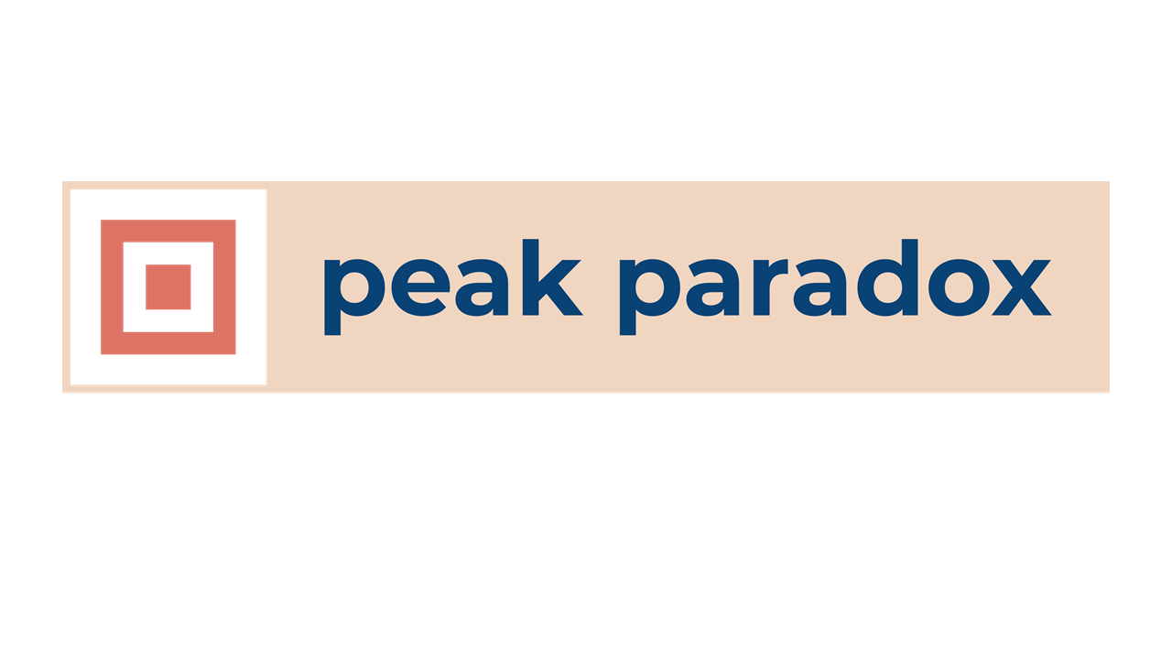
On discovering Peak Paradox
in everything where judgment is required
Note: Different purposes can have the same principles and values
Note: Peak means exclusive in single view so to avoid conflicts and compromises
Note: If there is no paradox, you are at the boundary edge of the peak where order is easy
Note: Peak paradox is the highest disorder
Note: We don’t have 183 biases at one time, we have a few
Full Agency (freedom)
Powerful
Voice that matters
Sovereign
Peak Individual Purpose
Invent and create
Being
Useful
Peak Human Purpose
Peak Organisation Purpose
Peak
Paradox
Survive
Escape death
Adapt and reproduce
Meet basic chemistry
Peak
paradox
Majority Thrive
Shareholder primacy
Commercial growth
Shared belief
Better
Ancestors
Creating
Impact
Peak Society/ Group Purpose
Education, Health and Safely for all
No suffering or poverty
Transparency
Equality
www.peakparadox.com
tony@peakparadox.com

Slide 2
Full Agency (freedom)
Powerful
Voice that matters
Sovereign
Peak Individual Purpose
Peak Human Purpose
Peak Organisation Purpose
Survive
Escape death
Adapt and reproduce
Meet basic chemistry
Peak
Paradox
Majority Thrive
Shareholder primacy
Commercial growth
Shared belief
Peak Society/ Group Purpose
Education, Health and Safely for all
No suffering or poverty
Transparency
Equality
www.peakparadox.com
tony@peakparadox.com

Slide 3
Peak Individual Purpose
Peak Human Purpose
Peak Organisation Purpose
Peak
Paradox
Peak Society/ Group Purpose
www.peakparadox.com

